Slide 1
HTML5 Media, Javascript Debugging and additional Javascript Libraries
IN712 Web3

Slide 2
HTML5 Media
The web started up as a text delivery system
Users demand for media content preceded the emergence of plug‐ins and third‐party applications that were designed to do things browsers normally didn’t, such as playing video and audio
Plug‐ins solved a particular problem, but they weren’t without their faults—the largest being the need for so many of them.
A wide variety of music and video formats were available, and certain plug‐ins would only play certain formats.
Stability was also an issue because a malfunctioning plug‐in could crash the browser.

Slide 3
HTML5 Media
Many people believe the browser should have the built‐in capability for playing video and audio
So the people developing the HTML5 specification included two new tags, <video> and <audio>, for that express purpose
video and audio are very similar; in fact, the primary difference between the two elements is that <audio/> elements have no playback area for visual content.
This discussion focuses primarily on video but the same concepts can be applied to audio
Before HTML5, embedding video within a web page was cumbersome because it required you to use no less than three elements for the video to work in all browsers.
With HTML5, however, all you need is the <video/> element:

Slide 4

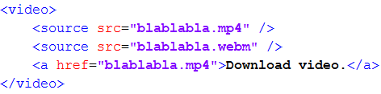
HTML5 Media
You can add some content inside the <video> element which will only display in browsers that do not support the <video> element
Often you will not use the src attribute. Instead you will include several sources within your <video> element to support different browser support for different video formats

Slide 5

HTML5 Media
By default, videos do not display controls, but you can easily add the default controls by adding the controls attribute to the <video> element
You can also tell the browser to preload the video with the preload attribute
By default, the browser uses the first frame of the video as the poster of the video, the initial visual representation of the video. You can use the poster attribute to display a custom image for the video’s poster

Slide 6
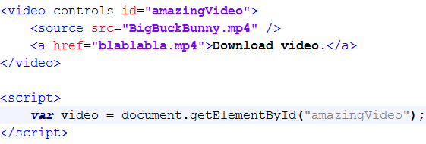
Scripting media
In the DOM, <video/> and <audio/> elements are HTMLMediaElement objects
the HTML5 specification defines an API for working with these objects.
You can retrieve an existing <video/> or <audio/> element in the page using any of the various methods for finding elements.

Slide 7
Media methods
Method name | description
canPlayType(mimeType) | Determines the likelihood that the browser can play media of the provided MIME type and/or codeccanPlayType(mimeType)
load() | Begins to load the media from the server
pause() | Pauses the media playback
play() | Begins or continues the playback of the media

Slide 8
Media properties
autoplay | Gets or sets the autoplay HTML attribute, indicating whether playback should automatically begin as soon as enough media is available
controls | Reflects the controls HTML attribute
currentTime | Gets the current playback time. Setting this property seeks the media to the new time.
duration | Gets the length of the media in seconds; zero if no media is available. Returns NaN if the duration cannot be determined
ended | Indicates whether the media element has ended playback
loop | Reflects the loop HTML attribute. Indicates whether the media element should start over when playback reaches the end
muted | Gets or sets whether the audio is muted
paused | Indicates whether the media is paused
playbackRate | Gets or sets the playback rate. 1.0 is normal speed.
poster | Gets or sets the poster HTML attribute
preload | Reflects the preload HTML element attribute
src | Gets or sets the src HTML attribute
volume | The audio volume. Valid values range from 0.0 (silent) to 1.0 (loudest).

Slide 9
Media events
Event Name | Description
abort | Fires when playback is aborted
canplay | Sent when enough data is available to play the media
canplaythrough | Indicates that the entire media can be played through without interruption
durationchange | The media’s metadata has changed, indicating a change in the media’s duration.
ended | Fires when playback completes
error | Sent when an error occurs
loadstart | Downloading has begun.
pause | Fires when playback is paused
playing | Sent when the media starts or resumes playing
progress | Downloading is in progress.
ratechange | Fires when the playback speed changes
seeked | Seeking has ended.
seeking | Fires when playback is moved to a new position
timeupdate | The currentTime property has changed.
volumechange | Either the volume property or muted property has changed.

Slide 11
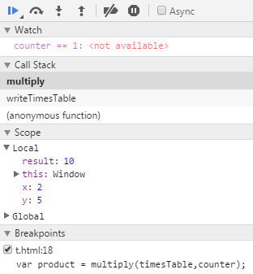
Javascript Debugging
Javascript debugging tools available for Internet Explorer, Firefox, Chrome, and Opera.
With these tools, you can halt the execution of your script with breakpoints and then step through code line by line to see exactly what is happening.
You can also find out what data is being held in variables and execute statements on the fly.

Slide 12
The following concepts apply to any debugger
Breakpoints tell the debugger it should break, or pause code execution, at a certain point.
Watches enable you to specify variables that you want to inspect when your code pauses at a breakpoint.
The call stack is a record of what functions and methods have been executed to the breakpoint.
The console enables you to execute JavaScript commands in the context of the page and within the scope of the breakpoint.
Stepping is the most common procedure in debugging. It enables you to execute one line of code at a time. You can step through code in three ways:
Step Into executes the next line of code. If that line is a function call, the debugger executes the function and halts at the first line of the function.
Step Over, like Step Into, executes the next line of code. If that line is a function, Step Over executes the entire function and halts at the first line outside the function.
Step Out returns to the calling function when you are inside a called function. Step Out resumes the execution of code until the function returns. It then breaks at the return point of the function.

Slide 14
Relevant Javascript Libraries other than jQuery

Slide 15
jQueryUI
jQueryUI is a free, open-source, JavaScript library that extends the usefulness of the jQuery library
Providing higher-level features for professional looking UI elements that you can use with a minimum of coding.
To provide these features, the jQuery UI utilizes the jQuery library.

Slide 16
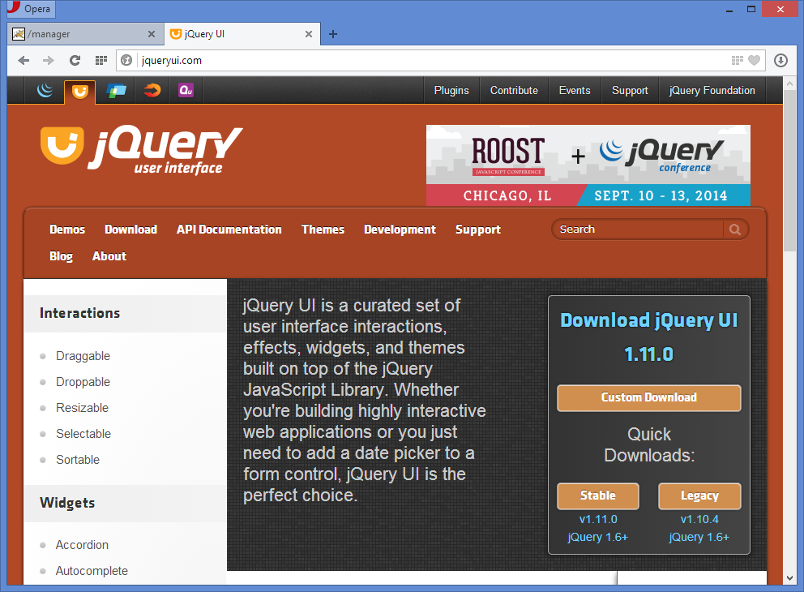

Slide 17
The jQuery UI
The jQuery UI home page summarizes the four types of features that the jQuery UI provides.
Themes provide the formatting for widgets
Implemented by a CSS style sheet part of the jQuery UI download.
When you build a download you can select one of the 24 pre-defined themes that come with jQuery UI, or you can create your own custom theme.
Widgets are features like accordions, tabs, sliders, date pickers…
Effects
Interactions

Slide 18
The jQuery UI
When you build a jQuery UI download, you decide which components you want to use in your web pages.
The fewer you choose, the smaller the jQuery UI files that has to be loaded into a user’s browser.
The core jQuery UI component is divided into core, widget, mouse, and position.
Core is always required when you use jQuery UI.
Widget is required if you use widgets.
Mouse is required if you use interactions.
Position is required if you use elements that require positioning relative to other elements on a web page.

Slide 19
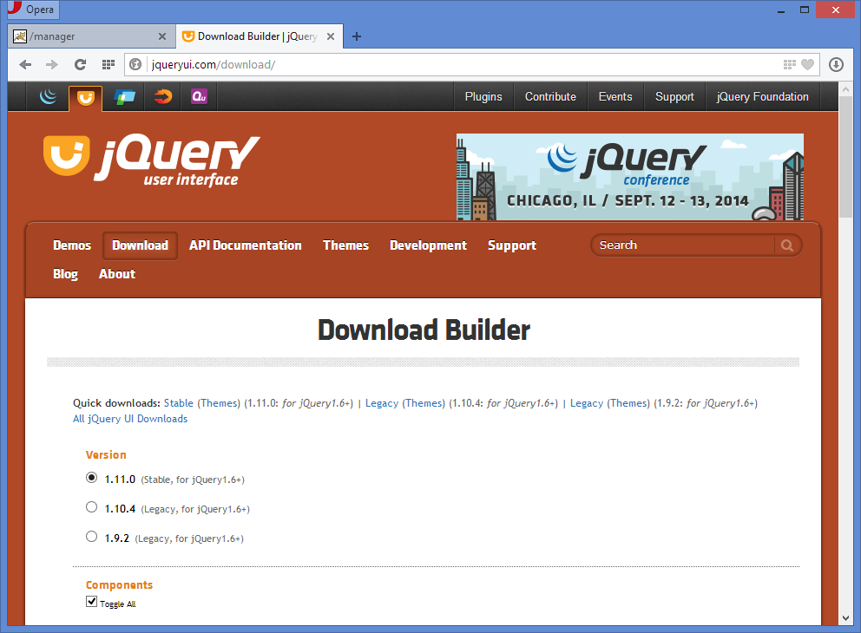

Slide 20
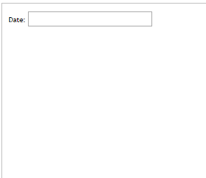
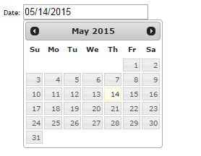
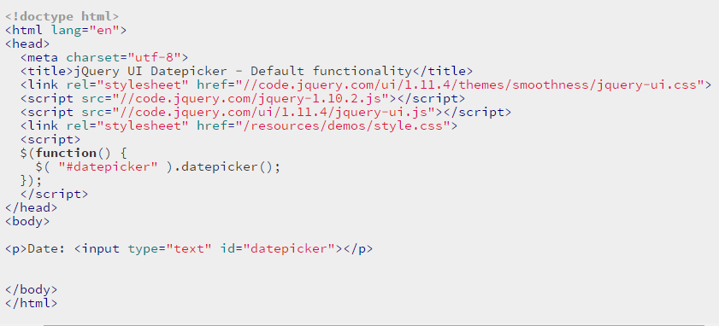

Slide 21
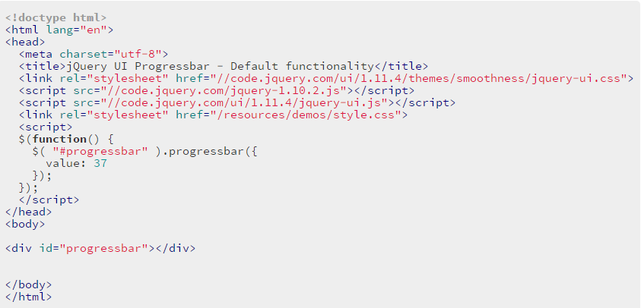

Slide 22
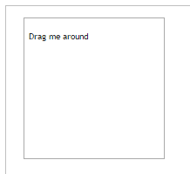
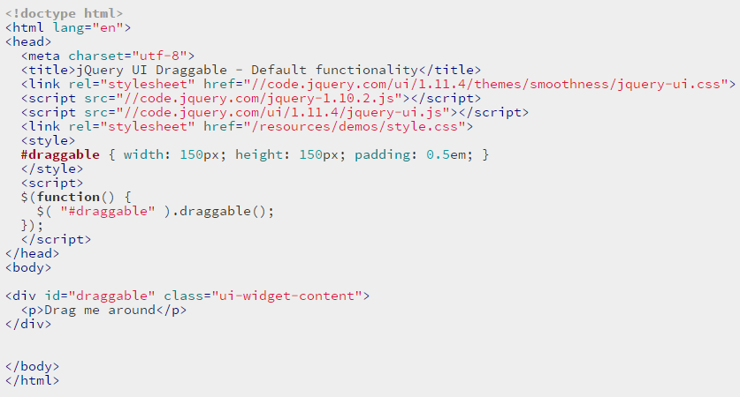

Slide 24
Other JavaScript libraries

Slide 25


Modernizr
HTML5 and CSS3 introduce many new features that some browsers haven’t yet implemented
Often you need to detect if a browser supports a certain feature
Modernizr provides a unified API for detecting HTML5 and CSS features in the browser
Like every other JavaScript library and framework, Modernizr is nothing more than a JavaScript file that you include within your page.

Slide 26
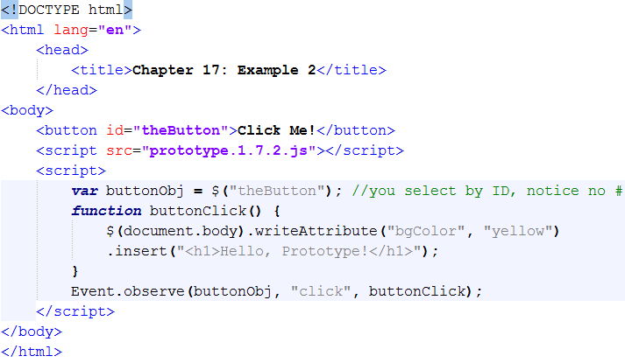
Prototype
Prototype’s focus is augmenting the way you program with JavaScript by providing classes and inheritance.
It also provide a robust set of tools for working with the DOM and Ajax support.
Sort of like jQuery, but jQuery is more popular

Slide 27
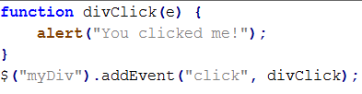
Mootools
MooTools is sort of a cross between jQuery and Prototype
Like Prototype, MooTools’ goal is to augment the way you write JavaScript, providing tools to write classes and inherit from them
Also like Prototype, MooTools adds in a rich set of extensions to make DOM manipulation easier, and you’ll find that selecting DOM objects in MooTools is exactly the same as Prototype
The extension method names and the way in which you use them in Mootools is reminiscent of jQuery

Slide 28
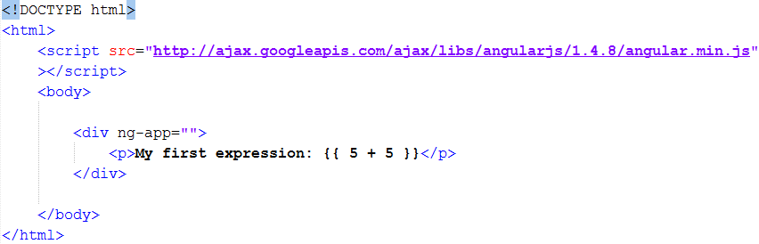
AngularJS
AngularJS extends HTML attributes with Directives, and binds data to HTML with Expressions.
AngularJS will resolve an expressions given a directive.

Slide 29
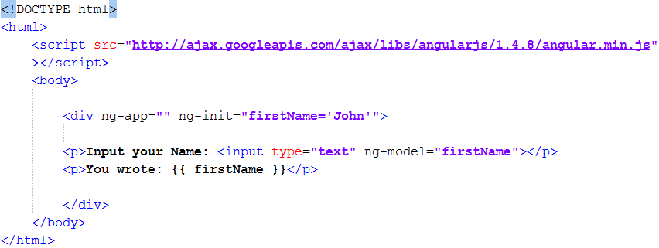
AngularJS
AngularJS directives are extended HTML attributes with the prefix ng-.
The ng-app directive initializes an AngularJS application.
The ng-init directive initializes application data.
The ng-model directive binds the value of HTML controls (input, select, textarea) to application data.
http://plnkr.co/edit/xm41urrC4V7i1FUCUGG1?p=preview

Slide 30
React
http://facebook.github.io/react/
JavaScript library for building user interfaces
The V in MVC
Abstracts away the DOM from you
providing a simpler programming model and better performance.

